Slide 1
BITS ZG553: Real Time Systems
K G Krishna
WILP Division, BITS-Pilani, Hyderabad

Slide 2

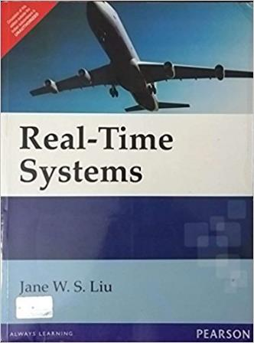
Text Book / References
Reference (R1)
Text Book (T1)
Note: As the above two books focus on theoretical treatment of the subject, Students are strongly advised to refer to web sources / MOOCs videos / library within their own organizations for more practical understanding of the topics.

Slide 3
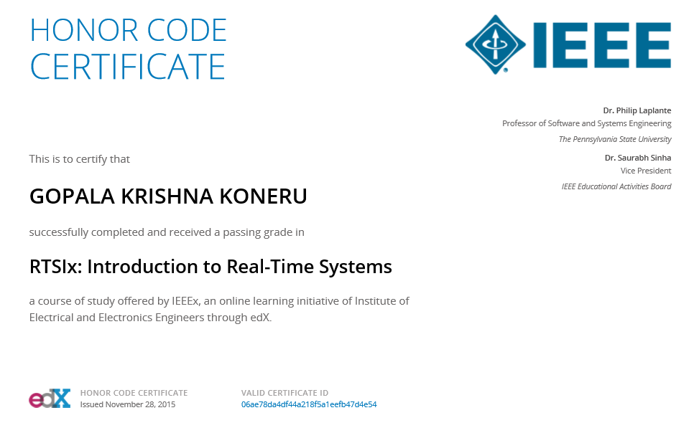
Excellent MOOCs Videos
(Coursera, edX,…)

Slide 4
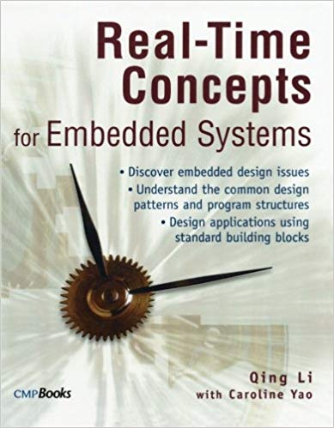
RTS Primer – For Light Reading

Slide 5
L-3: Introduction to Scheduling - Approaches/Algorithms
Ref: [Lecture PPT/Notes]
Note: Students are requested to NOT to rely on PPTs/Recorded sessions as their only source of knowledge, explore sources within your own organization or web for any specific topic; attend classes regularly and involve in discussions;
PLEASE DO NOT PRINT PPTs, Save the Environment!
Source PPT Courtesy: Some of the contents of this PPT is sourced from Presentations by Prof B Mishra / Prof K R Anupa, BITS-Pilani WILP Faculty

Slide 6
Timing Specifications – Periodic Task
deadline (D_{i})
deadline (D_{i+1})
response time
response time
execution time (e_{i})
execution time (e_{i+1})
T_{i}
T_{i+1}
period (p)
time
release time (r_{i})
release time(r_{i+1})

Slide 7
Timing Specifications – Aperiodic & Sporadic Task
deadline (D_{i})
response time
execution time (e_{i})
T_{i}
time
release time (r_{i})

Slide 8
Three Approaches for Scheduling Real Time System Tasks
Clock-driven
Round-robin / Weighted round-robin
Priority-driven

Slide 9
Clock-driven Approach
Scheduling decisions are made at specific time instants, which are chosen a priori before the system begins execution
Typically this type of scheduling is suitable for hard real-time systems and smaller systems, where the parameters are fixed and known.
Scheduling decisions are computed off-line and stored for use at run-time, thus scheduling overhead is minimal.
Generally a hardware time is set to expire periodically.
After the system gets initialized, the scheduler selects and schedules jobs which execute till the next scheduling decision is made. Then the scheduler blocks itself waiting for the expiration of the timer.
When the timer expires, the scheduler wakes up, does necessary scheduling and sleeps again. This process repeats.

Slide 10
Round-robin Approach
Also known as time-sharing
Every job joins a FIFO (First-in-first-out) queue when it becomes ready for execution
The entire time period is divided into several time-slices
The job at the head of the queue executes for one time-slice.
If the job doesn’t complete at the end of the time-slice, it gets pre-empted and placed at the end of the queue to waits for its next turn.
If there are ‘n’ jobs ready for execution, each job gets 1/nth share of the processor.

Slide 11
Round-robin Approach - Example
 | J_{1,1} | J_{2,1} | J_{1,2} | J_{2,2} | J_{1,3} | J_{2,3}
0
q
2q
3q
4q
5q
6q
time
(Round-robin execution of two tasks on a single processor)
(Time quantum = q)

Slide 12
Weighted round-robin Approach
This approach is a round robin approach with different weights assigned to different jobs.
If a job has weight ‘wt’, then it will get ‘wt’ time slices every round for execution.

Slide 13
Priority Driven Approach
Priorities are assigned to the jobs based on their criticality
Jobs ready for execution are placed in one or more queues ordered by priorities of the jobs.
At any scheduling decision time, the jobs with the highest priorities are scheduled and executed on the available processors.

Slide 14
Priority-Driven Approach - Example
3 Jobs to be scheduled based on priority-driven approach:
J1: priority 1, release time 15, execution time 10
J2: priority 2, release time 0, execution time 30
J3: priority 3, release time 18, execution time 20
Rules:
Each process has a fixed priority (1 highest);
Highest-priority ready process gets CPU;
Process continues until done.

Slide 15
Priority-Driven Approach - Example
J3 ready t=18
J2 ready t=0
J1 ready t=15
J2
J1
J2
J3
0
10
20
30
40
50
60
time

Slide 16
Priority-Driven vs Clock-Driven Approaches
Priority driven approaches have many advantages compared to clock driven approach:
They don’t have to have the information on the release time, execution time etc (in contrast with clock driven approach, where these parameters are required to be known a priori)
It is best suited for applications with varying time and resource requirements
Many well-known priority –driven algorithms use very simple priority assignments reducing the overhead of maintaining multiple queues.
Despite all these advantages, Clock-driven approaches are used for hard real-time systems, especially in safety-critical systems.
The major reason is that the timing behaviour of a priority-driven system is nondeterministic when job parameters vary.

Slide 17
What to do if CPU is getting overloaded ?
CPU is said to be overloaded, when the Utilization > 1.
What to do in this case?
Reduce Execution Time !
How to do it ?
Replace the CPU with a faster CPU
CPU with higher frequency
CPU with more cores
CPU with a deeper pipeline and more cache
Add more RAM (it will reduce the page fault overhead)
Have dedicated Hardware (e.g. custom ASICs, DSP Processors) for specific functions
Optimize the code
…

Slide 18
Let’s Examine each of the Scheduling Algorithms in little more detail…

Slide 19
How to Assign Priority to Jobs?
Based on Criticality ?
But on what is the basis of determining criticality?
Scheduling Algorithms comes for rescue.
Priorities of the jobs are determined by applying Scheduling algorithms.
Two types of Scheduling algorithms:
Fixed Priority Scheduling Algorithms:
Priorities of all the jobs of a task remain constant
(of course applicable for periodic tasks only)
Dynamic Priority Scheduling Algorithms
Priorities of the jobs of a task may vary

Slide 20
Rate Monotonic Scheduling Algorithm
Fixed priority algorithm
Shorter the period, higher the priority
Rate is inverse of the period. Hence higher the rate, higher the priority. – so the name ‘rate monotonic’
Example: Consider 3 periodic tasks with following timing parameters
T1: Release time 0, period 4, execution time 1, relative deadline 4
T2: Release time 0, period 5, execution time 2, relative deadline 5
T3: Release time 0, period 20, execution time 5, relative deadline 20
Schedule them applying RM Algorithm.

Slide 21
RM Scheduling Algorithm - Example (contd.)
Solution
T1: Release time 0, period 4, execution time 1, relative deadline 4
T2: Release time 0, period 5, execution time 2, relative deadline 5
T3: Release time 0, period 20, execution time 5, relative deadline 20
T1 has shortest period (i.e. 4), so should have higher priority, followed by T2 and T3.
T1
T2
T3
J_{1,1}
J_{1,2}
J_{1,3}
J_{1,4}
J_{1,5}
J_{1,6}
J_{2,1}
J_{2,2}
J_{2,3}
J_{2,4}
J_{2,4}
J_{3,1}
J_{3,1}
J_{3,1}
J_{3,1}
0
1
2
3
4
5
6
7
8
9
10
11
12
13
14
15
16
17
18
19
20
21

Slide 22
Deadline Monotonic (DM) Scheduling Algorithm
Fixed priority algorithm
Shorter the relative deadline, higher the priority
When the relative deadlines of every task is proportional to their period, the schedule produced by RM and DM algorithms are identical.
Example: 3 periodic tasks with following timing parameters
T1: Release time 50, period 50, execution time 25, relative deadline 100
T2: Release time 0, period 60, execution time 10, relative deadline 20
T3: Release time 0, period 125, execution time 25, relative deadline 50
Schedule them applying DM Algorithm.
Solution
According to DM algorithm, T2 has highest priority because its relative deadline is 20.
Similarly T1 has lowest priority and T3 has priority in between.

Slide 23
Deadline Monotonic (DM) – Example (contd.)
T1: Release time 50, period 50, execution time 25, relative deadline 100
T2: Release time 0, period 60, execution time 10, relative deadline 20
T3: Release time 0, period 125, execution time 25, relative deadline 50
T1
T2
T3
J_{1,1}
J_{1,1}
J_{1,2}
J_{1,2}
J_{1,3}
J_{1,3}
J_{1,4}
J_{2,1}
J_{2,2}
J_{2,3}
J_{2,4}
J_{3,1}
J_{3,2}
0
10
20
35
40
50
60
70
80
85
100
120
130
140
155
160
180
190
200
220
225
time

Slide 24
Earliest Deadline Fast (EDF) Scheduling Algorithm
Dynamic priority algorithm
Job with earliest (absolute) deadline has highest priority
Example: Consider two tasks
T1: Release time 0, period 2, execution time 0.9, relative deadline 2
T2: Release time 0, period 5, execution time 2.3, relative deadline 5
Schedule them applying EDF Algorithm.

Slide 25
EDF Algorithm – Example (contd.)
T1: Release time 0, period 2, execution time 0.9, deadline 2
T2: Release time 0, period 5, execution time 2.3, deadline 5
T1
T2
 | 0 | 1 | 2 | 3 | 4 | 5 | 6 | 7 | 8 | 9 | 10 | 11
J_{1,1}
J_{1,2}
J_{1,3}
J_{1,4}
J_{1,5}
J_{1,6}
J_{2,1}
J_{2,1}
J_{2,2}
J_{2,2}
J_{2,2}
J_{2,3}
Deadlines:
J_{1,1} : 2
J_{2,1} : 5
J_{1,1} scheduled
Deadlines:
J_{1,2} : 4
J_{2,1} : 5
J_{1,2} scheduled
Deadlines:
J_{1,3} : 6
J_{2,1} : 5
J_{2,1} scheduled
J_{2,2} only job
Deadlines:
J_{1,4} : 8
J_{2,2} : 10
J_{1,4} scheduled
Deadlines:
J_{1,5} : 10
J_{2,2} : 10
J_{1,5} scheduled
Deadlines:
J_{1,6} : 12
J_{2,3} : 15
J_{1,6} scheduled

Slide 26
LST (Least-Slack-Time-First) Scheduling Algorithm
Dynamic priority algorithm
Job with smallest slack has highest priority
At time t, the slack of a job whose remaining execution time is x and whose deadline is d = d - t- x
Note: Absolute deadline (d) = Release time + Relative deadline
Example: Consider two tasks
T1: Release time 0, period 2, execution time 0.9, relative deadline 2
T2: Release time 0, period 5, execution time 2.3, relative deadline 5
Schedule them applying LST Algorithm.

Slide 27
LST Algorithm – Example (contd.)
T1: Release time 0, period 2, execution time 0.9, relative deadline 2
T2: Release time 0, period 5, execution time 2.3, relative deadline 5
T1
T2
 | 0 | 1 | 2 | 3 | 4 | 5 | 6 | 7 | 8 | 9 | 10 | 11
J_{1,1}
J_{1,2}
J_{1,3}
J_{1,4}
J_{1,5}
J_{1,6}
J_{2,1}
J_{2,1}
J_{2,2}
J_{2,2}
J_{2,2}
J_{2,3}
Slack:
J_{1,1} : 1.1
J_{2,1} : 2.7
J_{1,1} scheduled
Slack:
J_{1,2} : 1.1
J_{2,1} : 1.8
J_{1,2} scheduled
Slack:
J_{1,3} : 1.1
J_{2,1} : 0.9
J_{2,1} scheduled
J_{2,2} only job
Slack:
J_{1,4} : 1.1
J_{2,2} : 2.7
J_{1,4} scheduled
Slack:
J_{1,5} : 1.1
J_{2,2} : 1.8
J_{1,5} scheduled
Slack:
J_{1,6} : 1.1
J_{2,3} : 2.7
J_{1,6} scheduled

Slide 28
Any Questions?

